Slide 1
Consciousness

Slide 2
Consciousness
Our awareness of ourselves and our environment.
Awareness of external events.
Awareness of internal sensations.
Awareness of yourself as the unique being having these experiences.
Awareness of your thoughts about these experiences.
Consciousness allows us to assemble information, reflect on the past, and plan for the future.

Slide 3


Slide 4
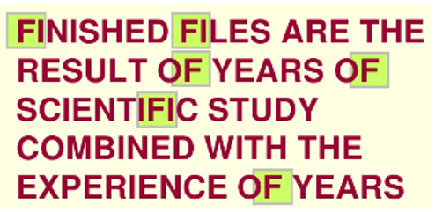

Slide 5
Attention
Dual- track mind
Controlled processing: generally govern novel or difficult tasks.
Automatic processing: generally govern familiar, well-practiced tasks or easy tasks.
As tasks are mastered, they can become automatic.
Pros and cons to automatic processing.
Speculated that 80%-90% of what we do is unconscious (Kandel, 2008).
Our conscious awareness focuses on a limited aspect of all that we experience.

Slide 6
Attention
Two competing needs:
Focus mental resources on the task at hand and not be distracted by irrelevant stimuli.
Monitor stimuli that are irrelevant in order to shift attention immediately if necessary.
Trick your vision with disappearing red circle! Global Flash Suppression Demo (youtube.com)

Slide 7


Slide 8


Slide 9


Slide 10


Slide 11


Slide 12


Slide 13


Slide 14


Slide 15
Preconscious
Priming: the activation, by sensory input, of information that is already stored in long-term memory.
Activation not experienced consciously, but influences consciousness.
TOWEL | SHOWER
SHAMPOO | SO_P
BROTH | CHOWDER
STEW | SO_P

Slide 16
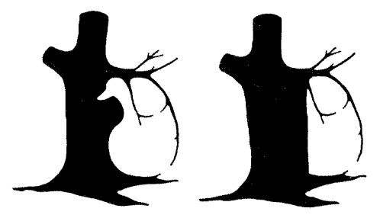
Preconscious
Preconscious awareness
Information that is available for cognitive processing but that currently lies outside of conscious awareness.
Priming is one of the ways to tap into the preconscious.

Slide 17
Attention Video
Test your awareness.

Slide 18
Attention
Selective Attention
A conscious process in which we determine where we want to focus our attention.
Flashlight analogy.
Cocktail party phenomenon
Can shift attentional focus.

Slide 19
Attention
Selective Inattention
Inattentional blindness
Unconsciously divert attention from information around us that we don’t deem important.
An unconscious process.
The "Door" Study - YouTube
https://www.youtube.com/watch?v=5igHSsydm1Q

Slide 20
Attention
Stroop test: Stroop Effect (washington.edu)
Parallel processing of both relevant and irrelevant information.
Automatic processes interfering with controlled processes.

Slide 21
Attention
Green & Baveller (2003) study on attentional capacity and action-playing gamers vs. non-gamers.
Target stimuli appeared in random places amid distracting stimuli: gamers correctly located twice as many target stimuli.
Non-gamers assigned to either play Medal of Honor or Tetris for 1 hour/day for 10 days, then tested on attentional capacity.

Slide 22
Sleep
Circadian rhythm: sleep/wake cycle.
Cyclical biological process revolving around daily cycles of light and dark.
Circadian rhythms change with age.
During periods of darkness, our body produces hormones called melatonin that makes us sleepy.
Melatonin levels rise at night and diminish during the day.
Increased melatonin linked to increased REM sleep.
Staring at a screen exposes eyes to excessive light and can disrupt melatonin production and circadian rhythm.

Slide 23
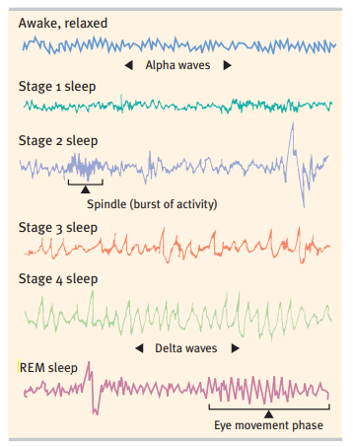
Roughly 5 cycles a night, 90 min. per cycle.
Stage 1
Relaxed
Stage 2
Brief
Brain waves slow, heart rate slows.
Body temperature decreases.
Sleep spindles.
Stage 3
Sleep deepens
Stage 4
Deep sleep
Muscles relax
Rejuvenating sleep

Slide 24
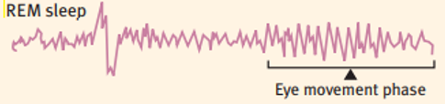
Stages of Sleep
REM sleep
Rapid Eye Movement
Body paralysis
Dreaming
Brain very active, similar to waking brain activity.
Increased heart rate & blood pressure.
https://www.youtube.com/watch?v=PCZSAwSasdQ

Slide 25
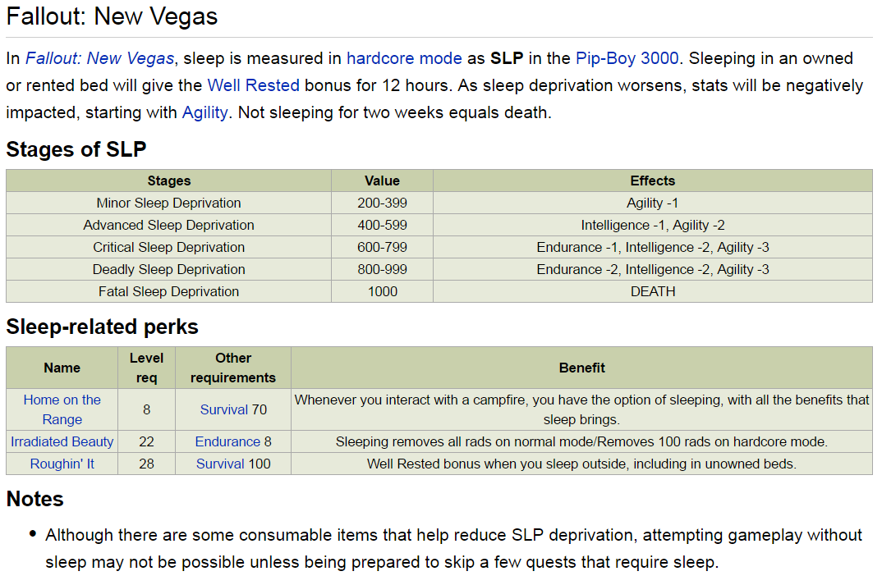

Slide 26
Sleep Benefits
Benefits:
Restores and repairs brain tissue.
Restores and rebuilds memories.
Boosts thinking and learning.
Improves recall.
Growth: pituitary gland releases growth hormone.

Slide 27
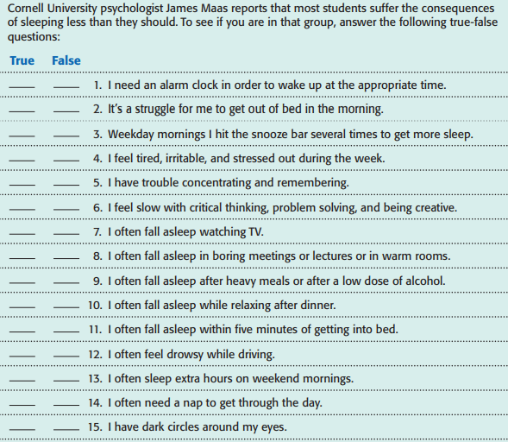

Slide 28
Sleep Deprivation: Short-term Effects
Cognitive slowing: slower reaction times, difficulty learning new information, difficulty paying attention, problems thinking clearly and problem solving.
Lack of creativity
Worse mood (e.g. irritable, moody, anxious)
Mild depression
Decreased motivation
Increased likelihood of spacing out, daydreaming.
Sleep debt: requiring several nights of extra sleep to catch up.

Slide 29
Sleep Deprivation: Long-term Effects
Reduces functioning of immune system.
Weight gain: increases production of stress hormones (cortisol) which stimulates body to make fat.
Disrupts body’s natural circadian rhythm and melatonin production.
Increased risk for high blood pressure, diabetes, heart problems.
Severe sleep deprivation can lead to experiencing auditory or visual hallucinations.
https://www.youtube.com/watch?v=7cECcb8ujQU

Slide 30
Sleep Disorders
Common sleep disorders
Insomnia
Narcolepsy
Sleep apnea
Sleep-walking, sleep-talking, sleep-eating, teeth grinding.
Consequences include:
Anxiety
Depression
Cognitive impairment

Slide 31
Insomnia
Chronic inability to fall asleep, stay asleep, or feel fully rested.
Possible causes:
Stress
Medications
Illness/ Medical issues
Jet lag
Caffeine
Napping

Slide 32
Insomnia
Treatments
Sleeping pills (significantly disrupts sleep patterns).
Keep regular sleep schedule.
Avoid caffeine after early afternoon.
Avoid bright lights/ screens before bedtime.
Relax before bedtime.
Avoid alcohol (reduces REM sleep).

Slide 33
Narcolepsy
Excessive daytime sleepiness or sudden, uncontrollable lapses into sleep during the day.
Lasts a few minutes.
Linked to absence of neurotransmitter or hormone that deals with alertness.
Can fall straight into REM sleep, leading to collapse/ loss of muscular tension (cataplexy).
No cure, but keeping a schedule, frequent naps, stimulants can help.

Slide 34
Sleep Study
Night study:
Hooked up to wires, investigated breathing problems, etc.
No abnormalities.
Day study:
An hour after they wake you from the night study, they let you try to take a nap.
If you can’t fall asleep, try again the next hour, and so on.
If you fall asleep, let you sleep 30 min.
Then another chance to nap, on the hour.
She fell asleep for all 6 naps.
Each nap took less than 2 min to fall asleep.

Slide 35
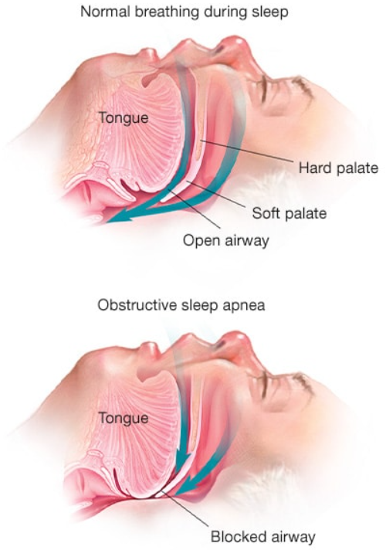
Sleep Apnea
Repeatedly choking and gasping during sleep.
Can occur every 1-2 minutes (300-500 times a night), often with no recollection of waking up.
Soft tissue in back of throat relaxes, causing airway blockage.
Disrupts sleep rhythms, lack of REM sleep.
Characterized by excessive snoring.

Slide 36
Sleep Apnea
Associated with increased risk of:
Stroke
Heart disease/ heart failure
Diabetes
High blood pressure
Lifestyle changes:
Weight loss
Quit smoking
Avoid alcohol, sleeping pills, sedatives
Maintain regular sleep hours

Slide 37
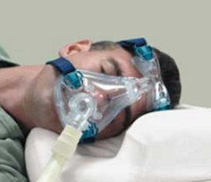
Sleep Apnea Treatments
Medical treatments:
Surgery to remove sagging or excess tissue in throat.
Pressurized oxygen mask to keep airway open.

Slide 38
Sleep Disorders
Sleep-walking, sleep-eating, sleep-talking
Occurs in Stage 3 or 4 of sleep.
Person often has no memory of these episodes.
No absolute cures.
Correlated with other anxiety disorders.
Recommendations to get adequate sleep and limit stress.

